Slide 1
FOM 2020
Managers
and Management
PowerPoint Presentation by Charlie Cook
Copyright © 2004 Prentice Hall, Inc.
All rights reserved.

Slide 2
L E A R N I N G O U T C O M E S
Describe the difference between managers and operative employees.
Explain what is meant by the term management.
Differentiate between efficiency and effectiveness.
Describe the four primary processes of management.
Classify the three levels of managers and identify the primary responsibility of each group.
1–<number>

Slide 3
L E A R N I N G O U T C O M E S (cont’d)
Summarize the essential roles performed by managers.
Discuss whether the manager’s job is generic.
Describe the four general skills necessary for becoming a successful manager.
Describe the value of studying management.
Identify the relevance of popular humanities and social science courses to management practices.
1–<number>

Slide 4
Organizations
Organization
  A systematic arrangement of people brought together to accomplish some specific purpose; applies to all organizations—for-profit as well as not-for-profit organizations.
  Where managers work (manage)
Common characteristics
  Goals
  Structure
  People
1–<number>

Slide 5
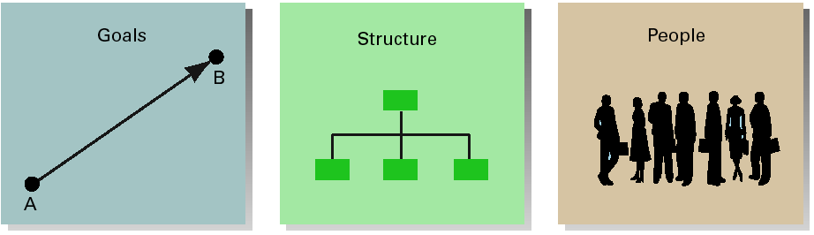
Common Characteristics of Organizations
EXHIBIT 1.1
1–<number>

Slide 6

People Differences
Operatives
  People who work directly on a job or task and have no responsibility for overseeing the work of others
Managers
  Individuals in an organization who direct the activities of others
1–<number>

Slide 7
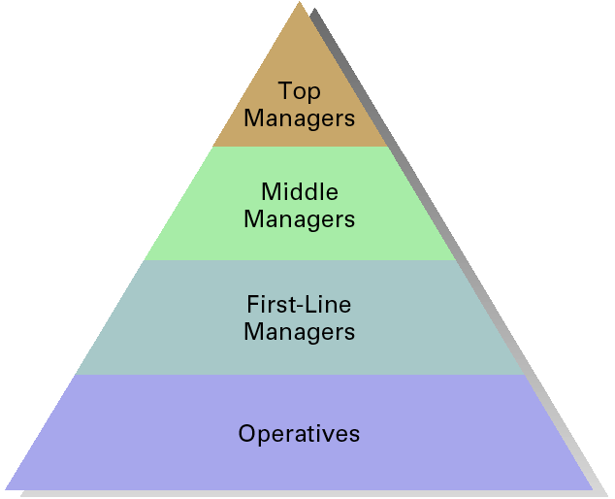
Organizational Levels
EXHIBIT 1.2
1–<number>

Slide 8
Identifying Managers
First-line managers
  Supervisors responsible for directing the day-to-day activities of operative employees
Middle managers
  Individuals at levels of management between the first-line manager and top management
Top managers
  Individuals who are responsible for making decisions about the direction of the organization and establishing policies that affect all organizational members
Copyright © 2004 Prentice Hall, Inc. All rights reserved.
1–<number>

Slide 9
Management Defined
Management
  The process of getting things done, effectively and efficiently, through and with other people
  Efficiency
    Means doing the thing correctly; refers to the relationship between inputs and outputs; seeks to minimize resource costs
  Effectiveness
    Means doing the right things; goal attainment
Copyright © 2004 Prentice Hall, Inc. All rights reserved.
1–<number>

Slide 10
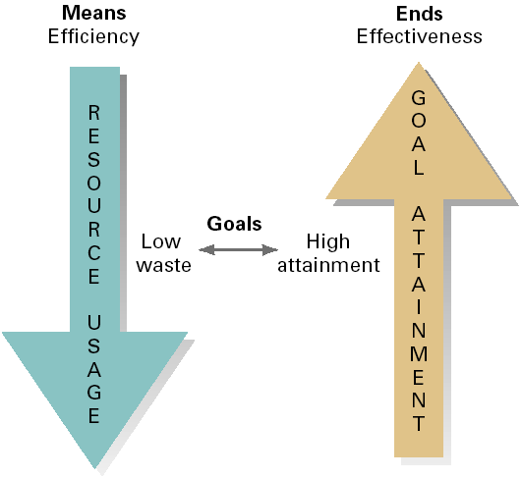
Efficiency and Effectiveness
Copyright © 2004 Prentice Hall, Inc. All rights reserved.
EXHIBIT 1.3
1–<number>

Slide 11
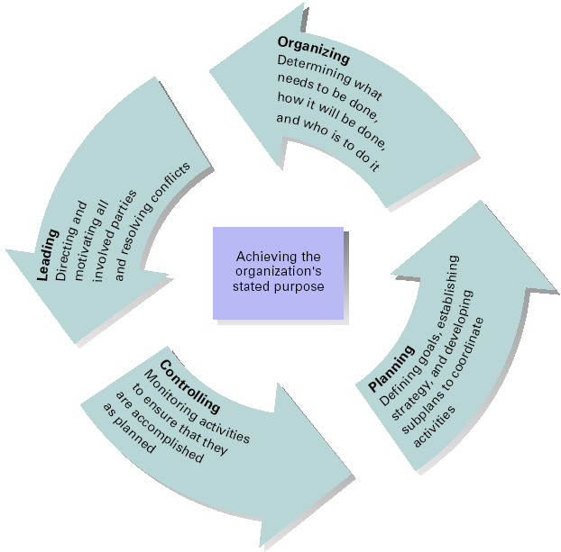
Management
Process
Activities
Management process:
planning, organizing, leading, and controlling
Copyright © 2004 Prentice Hall, Inc. All rights reserved.
EXHIBIT 1.4
1–<number>

Slide 12

Management Process
Planning
  Includes defining goals, establishing strategy, and developing plans to coordinate activities
Organizing
  Includes determining what tasks
  to be done, who is to do them,
  how the tasks are to be
  grouped, who reports to
  whom, and where
  decisions are to be made
Copyright © 2004 Prentice Hall, Inc. All rights reserved.
1–<number>

Slide 13

Management Process
Leading
  Includes motivating employees, directing the activities of others, selecting the most effective communication channel, and resolving conflicts
Controlling
  The process of monitoring performance,
  comparing it with goals, and
  correcting any significant
  deviations
Copyright © 2004 Prentice Hall, Inc. All rights reserved.
1–<number>

Slide 14

Mintzberg’s Managerial Roles
Interpersonal
  Figurehead
  Leader
  Liaison
Informational
  Monitor
  Disseminator
  Spokesperson
Decisional
  Entrepreneur
  Disturbance hander
  Resource allocator
  Negotiator
Source: Adapted from The Nature of Managerial Work (paperback) by H. Mintzberg, Table 2, pp.92–93. Copyright © 1973 Addison Wesley Longman. Reprinted by permission of Addison Wesley Longman.
EXHIBIT 1.5
Copyright © 2004 Prentice Hall, Inc. All rights reserved.
1–<number>

Slide 15
Is The Manager’s Job Universal?
Level in the organization
  Do managers manage differently based on where they are in the organization?
Profit versus not-for-profit
  Is managing in a commercial enterprise different than managing in a non-commercial organization?
Size of organization
  Does the size of an organization affect how managers function in the organization?
Management concepts and national borders
  Is management the same in all economic, cultural, social and political systems?
Copyright © 2004 Prentice Hall, Inc. All rights reserved.
1–<number>

Slide 16
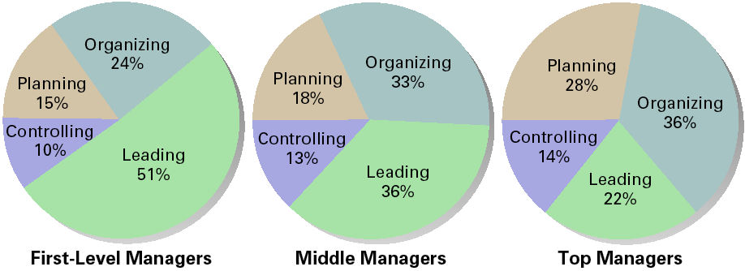
Distribution of Time per Activity by Organizational Level
Source: Adapted from T. A. Mahoney, T. H. Jerdee, and S. J. Carroll, “The Job(s) of Management,” Industrial Relations 4, No.2 (1965), p.103.
EXHIBIT 1.6
Copyright © 2004 Prentice Hall, Inc. All rights reserved.
1–<number>

Slide 17
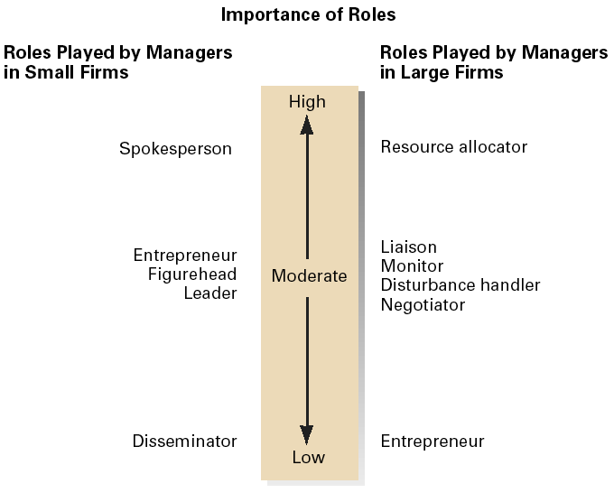
Importance of Managerial Roles in Small and Large Businesses
Source: Adapted from J. G. P. Paolillo, “The Manager’s Self Assessments of Managerial Roles: Small vs. Large Firms,” American Journals of Small Business, January–March 1984, pp.61–62.
EXHIBIT 1.7
Copyright © 2004 Prentice Hall, Inc. All rights reserved.
1–<number>

Slide 18
General Skills for Managers
Conceptual skills
  A manager’s mental ability to coordinate all of the organization’s interests and activities
Interpersonal skills
  A manager’s ability to work with, understand, mentor, and motivate others, both individually and in groups
Technical skills
  A manager’s ability to use the tools, procedures, and techniques of a specialized field
Political skills
  A manager’s ability to build a power base and establish the right connections
Copyright © 2004 Prentice Hall, Inc. All rights reserved.
1–<number>

Slide 19
Specific Skills for Managers
Behaviors related to a manager’s effectiveness:
  Controlling the organization’s environment and its resources.
  Organizing and coordinating.
  Handling information.
  Providing for growth and development.
  Motivating employees and handling conflicts.
  Strategic problem solving.
Copyright © 2004 Prentice Hall, Inc. All rights reserved.
1–<number>

Slide 20
Management Charter Initiative Competencies for Middle Managers
Initiate and implement change and improvement in services, products, and systems
Monitor maintain, and improve service and product delivery
Monitor and control the use of resources
Secure effective resource allocation for activities and projects
Recruit and select personnel
Develop teams, individuals, and self to enhance performance
Plan, allocate, and evaluate work carried out by teams, individuals and self
Create, maintain, and enhance effective working relationships
Seek, evaluate, and organize information for action
Exchange information to solve problems and make decisions
Copyright © 2004 Prentice Hall, Inc. All rights reserved.
EXHIBIT 1.8
1–<number>

Slide 21
How Much Importance Does The Marketplace Put On Managers?
Good (effective) managerial skills are a scarce commodity.
  Managerial compensation packages are one measure of the value that organizations place on them.
  Management compensation reflects the market forces of supply and demand.
    Management superstars, like superstar athletes in professional sports, are wooed with signing bonuses, interest-free loans, performance incentive packages, and guaranteed contracts.
Copyright © 2004 Prentice Hall, Inc. All rights reserved.
1–<number>

Slide 22
Why Study Management?
We all have a vested interest in improving the way organizations are managed.
  Better organizations are, in part, the result of good management.
You will eventually either manage or be managed
  Gaining an understanding of the management process provides the foundation for developing management skills and insight into the behavior of individuals and the organizations.
Copyright © 2004 Prentice Hall, Inc. All rights reserved.
1–<number>

Slide 23
How Does Management Relate To Other Disciplines?
Sociology
Political Science
Psychology
Management
Economics
Philosophy
Anthropology
Copyright © 2004 Prentice Hall, Inc. All rights reserved.
1–<number>

Slide 24
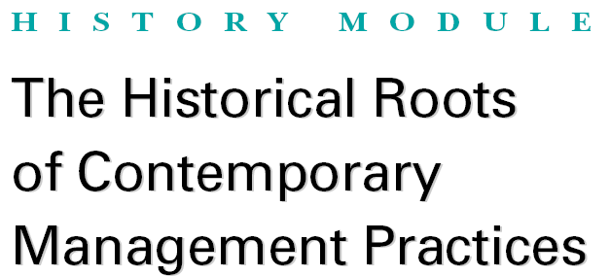
Copyright © 2004 Prentice Hall, Inc. All rights reserved.
1–<number>

Slide 25



The Pre-modern Era
Ancient massive construction projects
  Egyptian pyramids
  Great Wall of China
Michelangelo the manager
Copyright © 2004 Prentice Hall, Inc. All rights reserved.
1–<number>

Slide 26
Adam Smith’s Contribution To The Field Of Management
Wrote the Wealth of Nations (1776)
  Advocated the economic advantages that organizations and society would reap from the division of labor:
    Increased productivity by increasing each worker’s skill and dexterity.
    Time saved that is commonly lost in changing tasks.
    The creation of labor-saving inventions and machinery.
Copyright © 2004 Prentice Hall, Inc. All rights reserved.
1–<number>

Slide 27
The Industrial Revolution’s Influence On Management Practices
Industrial revolution
  Machine power began to substitute for human power
    Lead to mass production of economical goods
  Improved and less costly transportation systems became available
    Created larger markets for goods.
  Larger organizations developed to serve larger markets
    Created the need for formalized management practices.
Copyright © 2004 Prentice Hall, Inc. All rights reserved.
1–<number>

Slide 28
Classical Contributions
Classical approach
  The term used to describe the hypotheses of the scientific management theorists and the general administrative theorists.
    Scientific management theorists
      Fredrick W. Taylor, Frank and Lillian Gilbreth, and Henry Gantt
    General administrative theorists
      Henri Fayol and Max Weber
Copyright © 2004 Prentice Hall, Inc. All rights reserved.
1–<number>

Slide 29
Scientific Management
Frederick W. Taylor
  The Principles of Scientific Management (1911)
    Advocated the use of the scientific method to define the “one best way” for a job to be done
  Believed that increased efficiency could be achieved by selecting the right people for the job and training them to do it precisely in the one best way.
  To motivate workers, he favored incentive wage plans.
  Separated managerial work from operative work.
Copyright © 2004 Prentice Hall, Inc. All rights reserved.
1–<number>

Slide 30
Taylor’s Four Principles of Management
Develop a science for each element of an individual’s work, which replaces the old rule-of-thumb method.
Scientifically select and then train, teach, and develop the worker. (Previously, workers chose their own work and trained themselves as best they could.)
Heartily cooperate with the workers so as to ensure that all work is done in accordance with the principles of the science that has been developed.
Divide work and responsibility almost equally between management and workers. Management takes over all work for which it is better fitted than the workers. (Previously, almost all the work and the greater part of the responsibility were thrown upon the workers).
Copyright © 2004 Prentice Hall, Inc. All rights reserved.
EXHIBIT HM–1
1–<number>

Slide 31
Scientific Management Contributors
Frank and Lillian Gilbreth
  Bricklaying efficiency improvements
  Time and motion studies (therbligs)
Henry Gantt
  Incentive compensation systems
  Gantt chart for scheduling work operations
Copyright © 2004 Prentice Hall, Inc. All rights reserved.
1–<number>

Slide 32
Administrative Management
General administrative theorists
  Writers who developed general theories of what managers do and what constitutes good management practice
  Henri Fayol (France)
    Fourteen Principles of Management: Fundamental or universal principles of management practice
  Max Weber (Germany)
    Bureaucracy: Ideal type of organization characterized by division of labor, a clearly defined hierarchy, detailed rules and regulations, and impersonal relationships
Copyright © 2004 Prentice Hall, Inc. All rights reserved.
1–<number>

Slide 33
Fayol’s Fourteen Principles of Management
Division of work
Authority
Discipline
Unity of command
Unity of direction
Subordination of the individual
Remuneration
Centralization
Scalar chain
Order
Equity
Stability of tenure of personnel
Initiative
Esprit de corps
Copyright © 2004 Prentice Hall, Inc. All rights reserved.
EXHIBIT HM–2
1–<number>

Slide 34
Weber’s Ideal Bureaucracy
Division of Labor
Authority Hierarchy
Formal Selection
Formal Rules and Regulations
Impersonality
Career Orientation
Copyright © 2004 Prentice Hall, Inc. All rights reserved.
EXHIBIT HM–3
1–<number>

Slide 35
Human Resources Approach
Robert Owen
  Claimed that a concern for employees was profitable for management and would relieve human misery.
Hugo Munsterberg
  Created the field of industrial psychology—the scientific study of individuals at work to maximize their productivity and adjustment.
Copyright © 2004 Prentice Hall, Inc. All rights reserved.
1–<number>

Slide 36
Human Resources Approach
Mary Parker Follett
  Recognized that organizations could be viewed from the perspective of individual and group behavior.
Chester Barnard
  Saw organizations as social systems that require human cooperation.
  Expressed his views in his book The Functions of the Executive (1938).
Copyright © 2004 Prentice Hall, Inc. All rights reserved.
1–<number>

Slide 37
Hawthorne Studies
A series of studies done during the 1920s and 1930s that provided new insights into group norms and behaviors
  Hawthorne effect
    Social norms or standards of the group are the key determinants of individual work behavior.
Changed the prevalent view of the time that people were no different than machines.
Copyright © 2004 Prentice Hall, Inc. All rights reserved.
1–<number>

Slide 38
Human Relations Movement
Based on a belief in the importance of employee satisfaction—a satisfied worker was believed to be a productive worker.
Advocates were concerned with making management practices more humane.
  Dale Carnegie
  Abraham Maslow
  Douglas McGregor
Copyright © 2004 Prentice Hall, Inc. All rights reserved.
1–<number>

Slide 39
The Quantitative Approach
Operations research (management science)
  Evolved out of the development of mathematical and statistical solutions to military problems during World War II.
  Involves the use of statistics, optimization models, information models, and computer simulations to improve management decision making for planning and control.
Copyright © 2004 Prentice Hall, Inc. All rights reserved.
1–<number>

Slide 40
Social Events That Shaped Management Approaches
Classical approach
  Desire for increased efficiency of labor intensive operations
Human resources approach
  The backlash to the overly mechanistic view of employees held by the classicists.
  The Great Depression.
The quantitative approaches
  World War II
Copyright © 2004 Prentice Hall, Inc. All rights reserved.
1–<number>

Slide 41
The Process Approach
Management theory jungle (Harold Koontz)
  The diversity of approaches to the study of management—functions, quantitative emphasis, human relations approaches—each offer something to management theory, but many are only managerial tools.
Planning, leading, and controlling activities are circular and continuous functions of management.
Copyright © 2004 Prentice Hall, Inc. All rights reserved.
1–<number>

Slide 42
The Systems Approach
Defines a system as a set of interrelated and interdependent parts arranged in a manner that produces a unified whole
  Closed system : a system that is not influenced by and does not interact with its environment
  Open system: a system that dynamically interacts with its environment
  Stakeholders: any group that is affected by organizational decisions and policies
Copyright © 2004 Prentice Hall, Inc. All rights reserved.
1–<number>

Slide 43
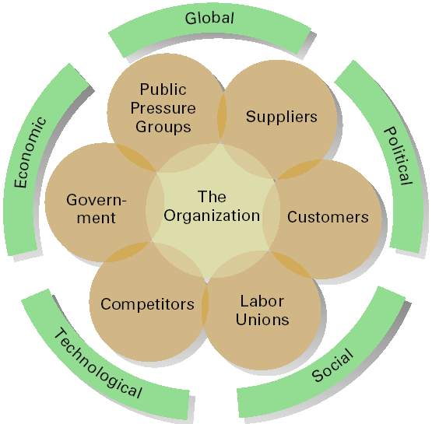
The Organization and its Environment
Copyright © 2004 Prentice Hall, Inc. All rights reserved.
EXHIBIT HM–4
1–<number>

Slide 44
The Contingency Approach
The situational approach to management that replaces more simplistic systems and integrates much of management theory
Four popular contingency variables
  Organization size
  Routineness of task technology
  Environmental uncertainty
  Individual differences
Copyright © 2004 Prentice Hall, Inc. All rights reserved.
1–<number>

